Slide 1
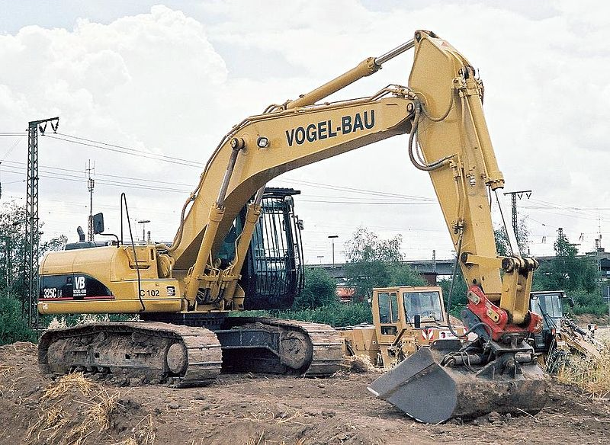
A typical modern excavator

Slide 2
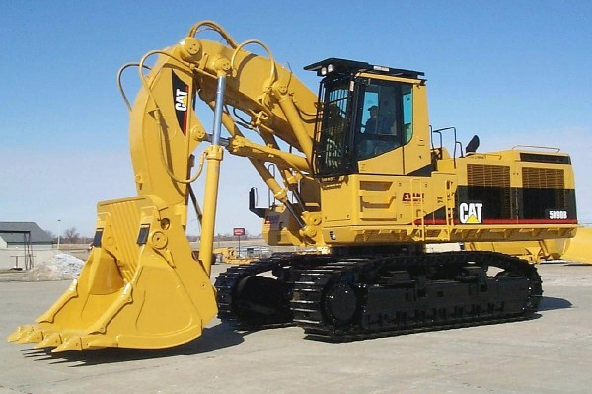
Tracked excavator

Slide 3
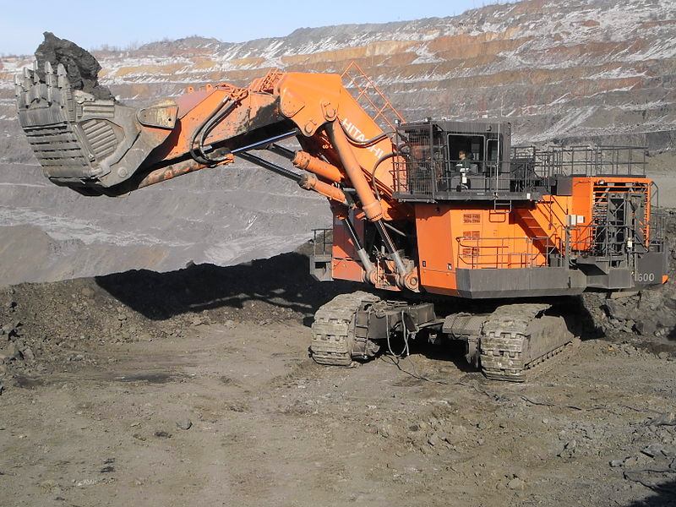
Front shovel excavator

Slide 4
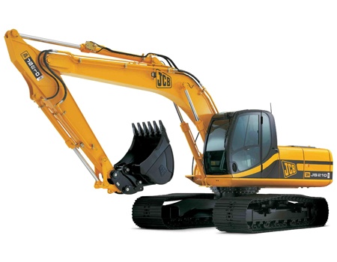
Excavator with backhoe

Slide 5
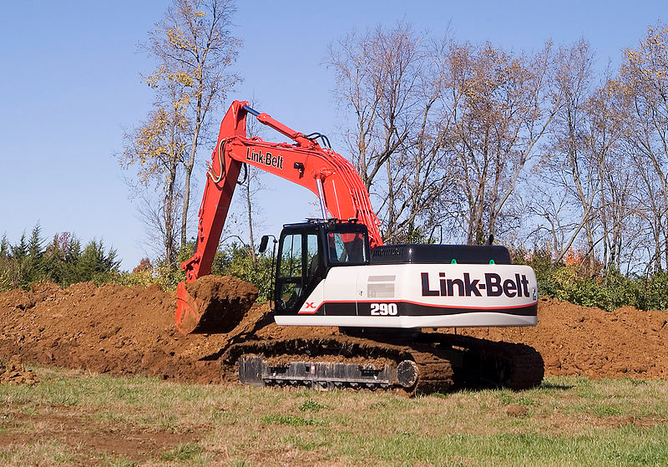
Link-Belt excavator trenching

Slide 6
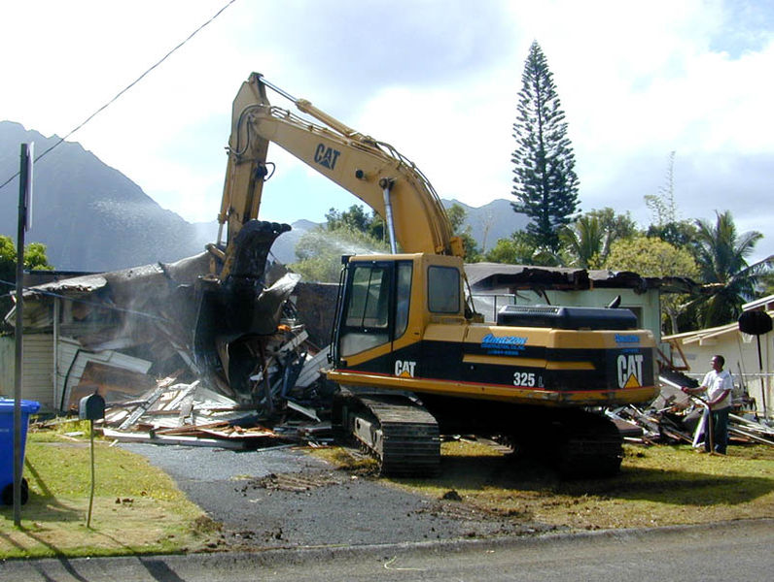
Excavator demolishing a house

Slide 7
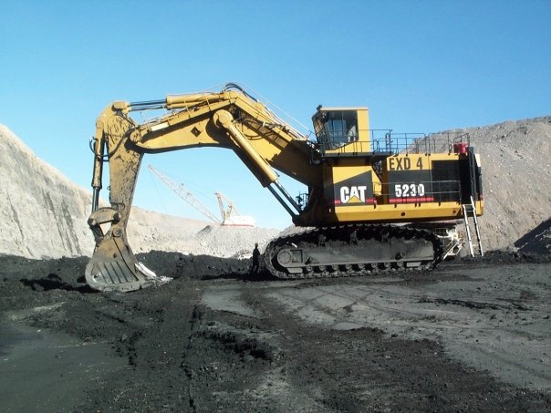
CAT 5230 in coal mining operation

Slide 8
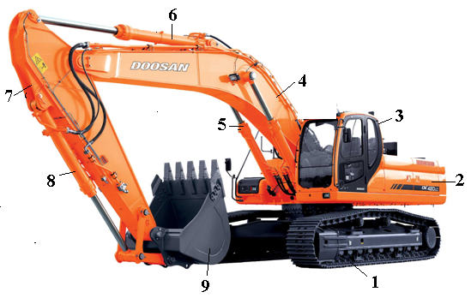
Excavator consists of the main components: 1 - tracked chassis, 2 - power part 3 - cab, 4 - arrow, 5 - Hydraulic cylinder control boom, 6 - cylinder control handle, 7 - handle 8 - cylinder management Furnace 9 - bucket.

Slide 9
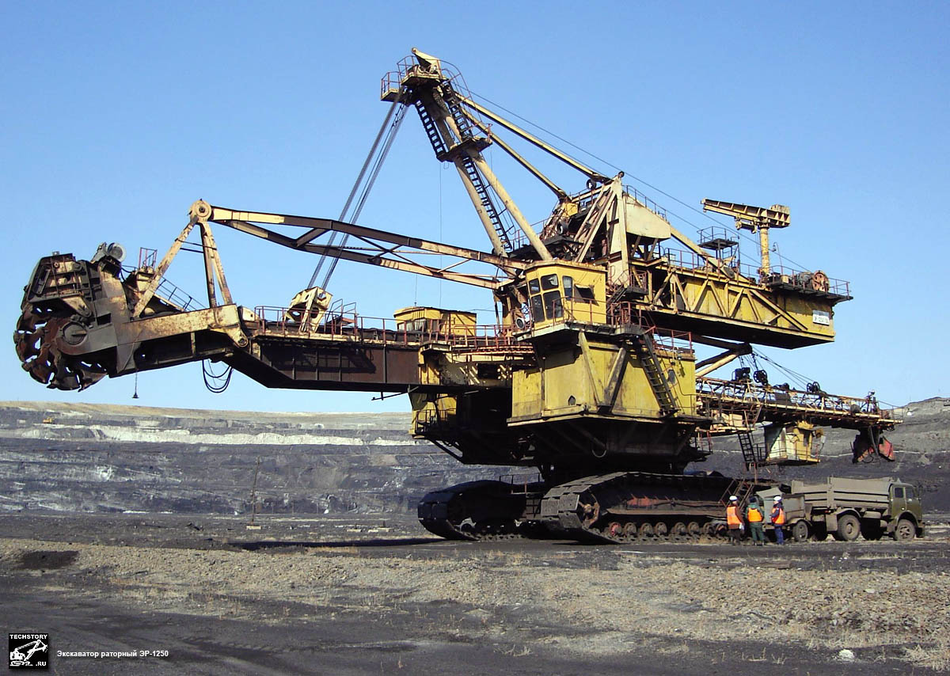
Backetweel-excavator

Slide 10
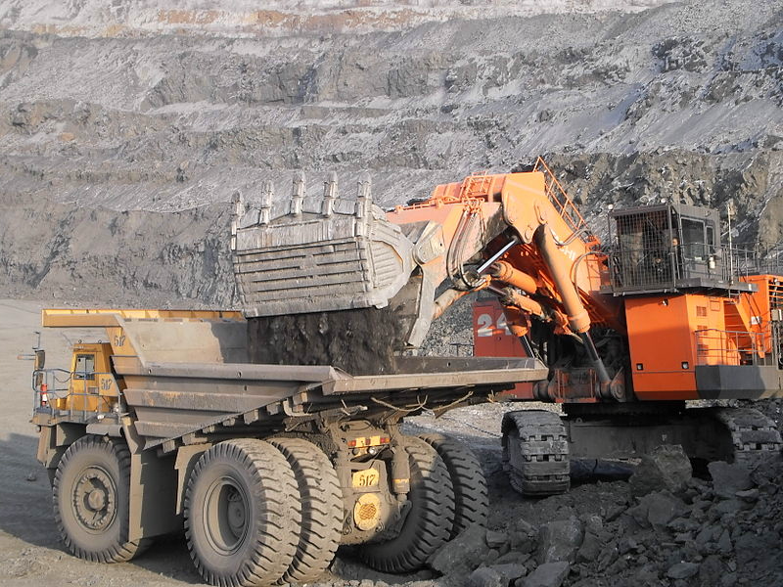
Excavator in work

